Slide 1
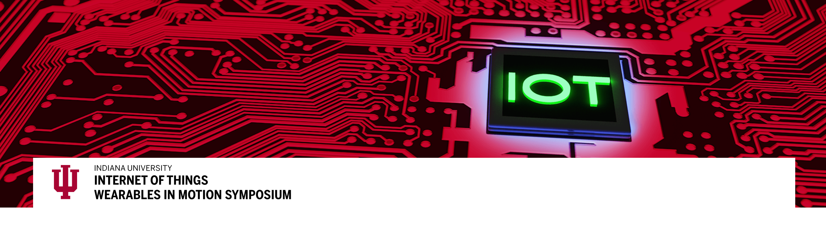

#IU-IoT
The Indiana University School of Informatics, Computing, and Engineering—in close collaboration with Innovate Indiana, the IU Research and Technology Corp., The Mill and the Indiana IoT Lab—will host academic and industrial experts to discuss wearables and the Internet of Things (IoT).
The symposium will bring together thought leaders and innovative product developers that design IoT wearables for fashion, athletics, medical, and military applications. Topics to be addressed include novel sensors and actuators, scalable and secure cyberinfrastructures, ownership of generated data, fashion trends in wearables, visual analytics of IoT data, and more.
We gratefully acknowledge financial and in-kind support for this event: Cyberinfrastructure for Network Science Center; Indiana University School of Informatics, Computing, and Engineering; Innovate Indiana; the IU Research and Technology Corp.; The Mill; the Regional Economic Development (RED) Fund; and the Indiana IoT Lab.

Slide 2
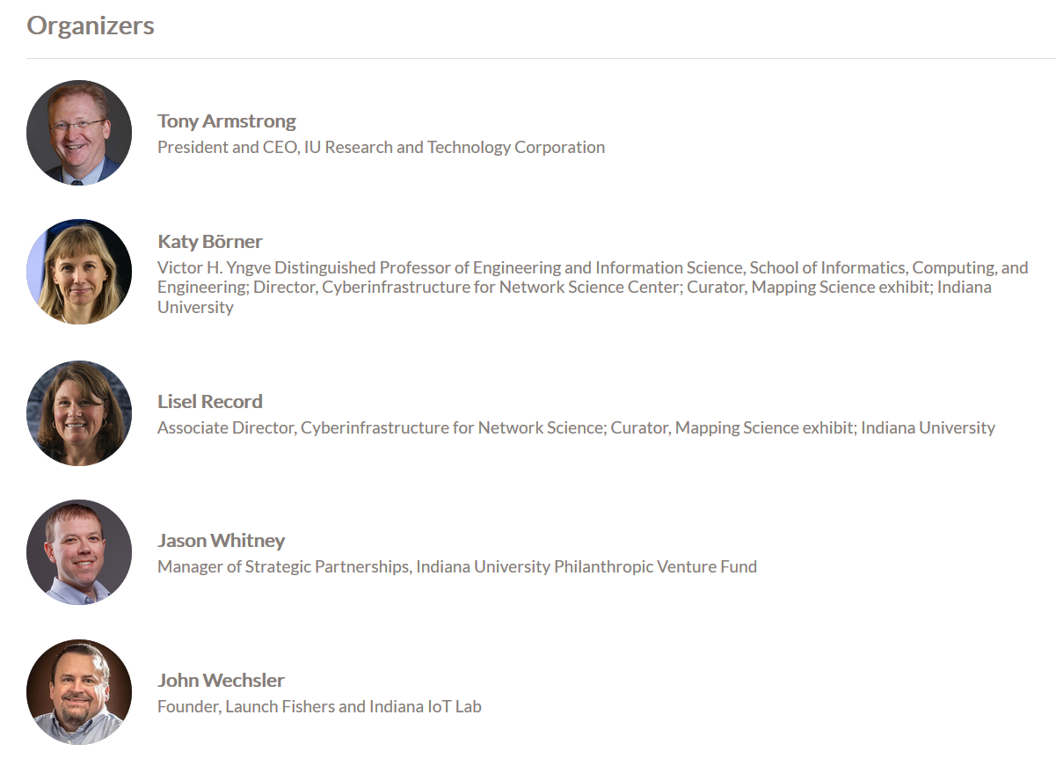
#IU-IoT

Slide 3
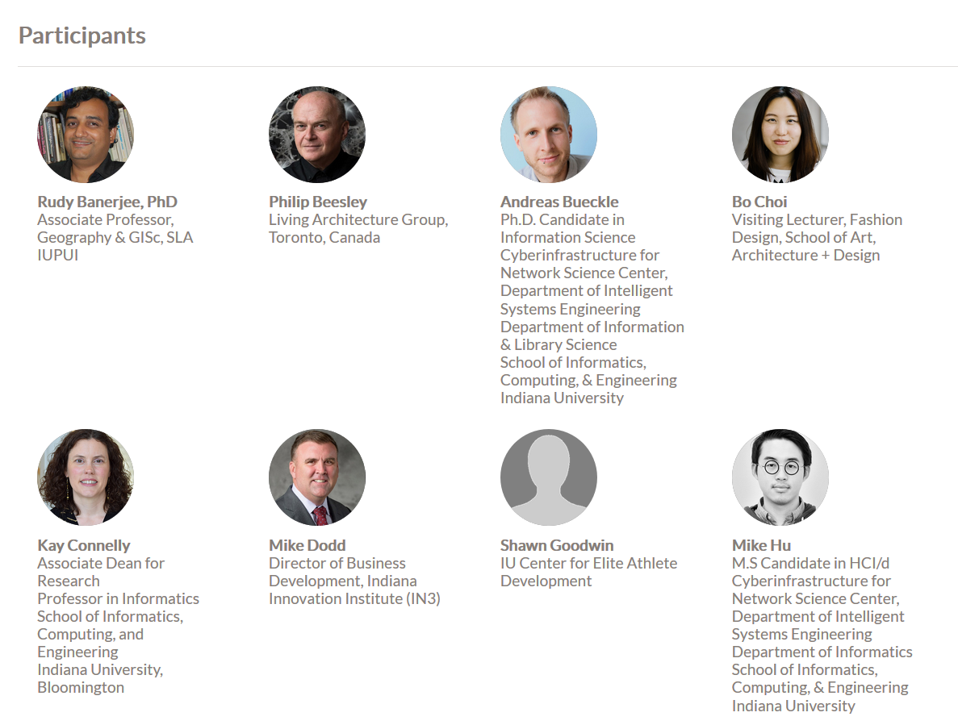

Slide 4
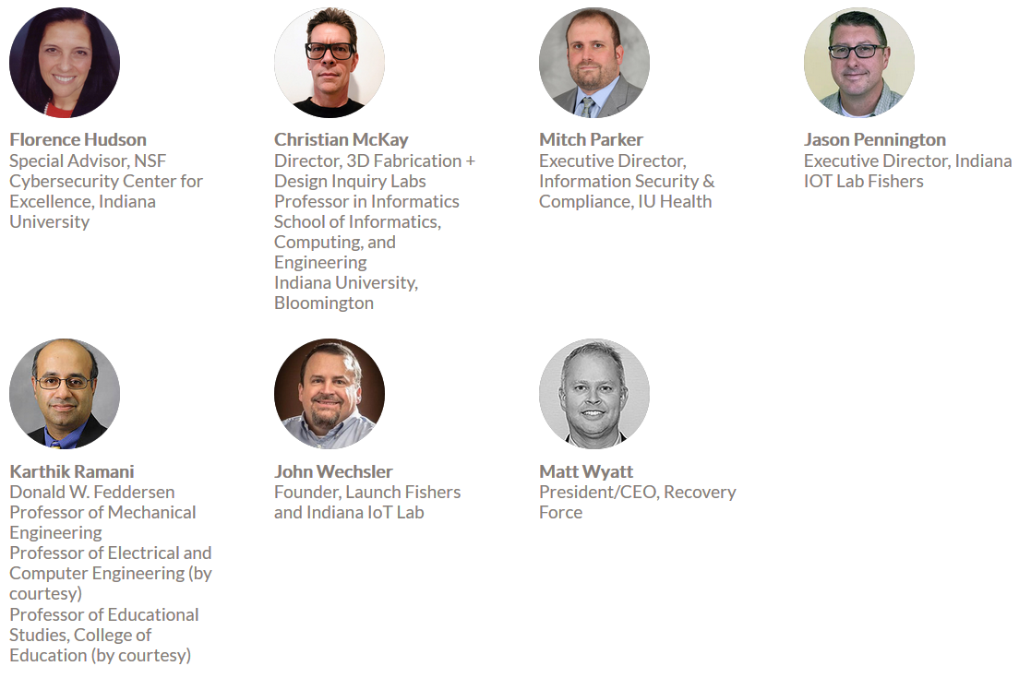
Terrell Glenn
IoT & interactive interfaces space.

Slide 5
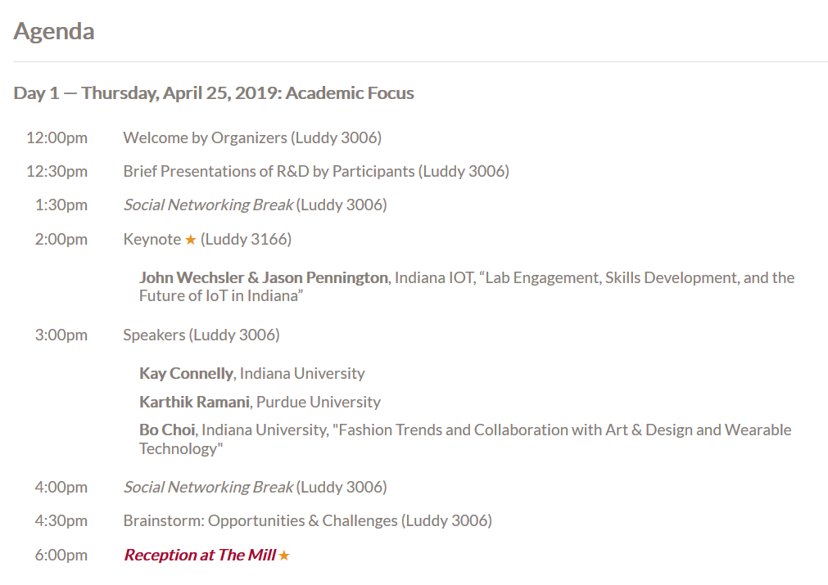
#IU-IoT

Slide 6
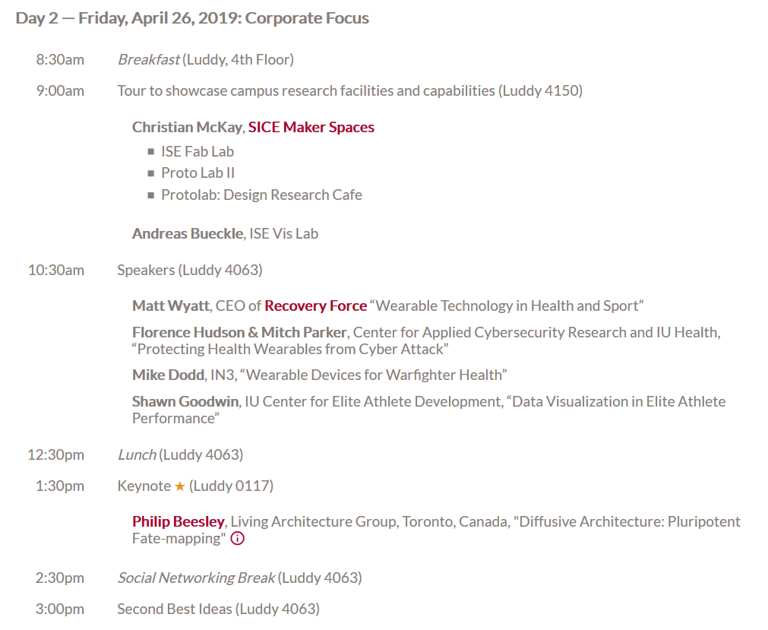
#IU-IoT

Slide 7


Slide 8
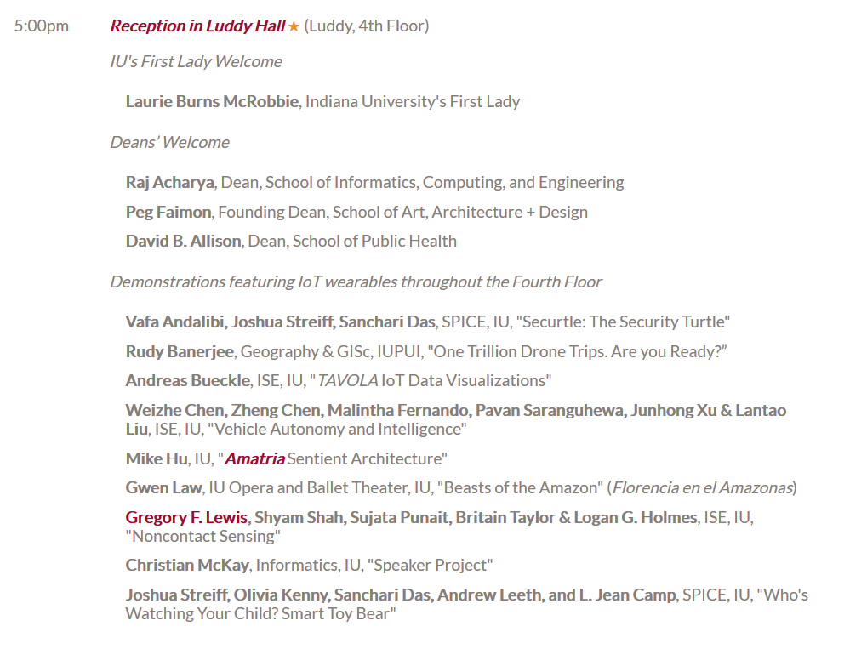
#IU-IoT

Slide 9
#IU-IoT
The Indiana University School of Informatics, Computing, and Engineering—in close collaboration with Innovate Indiana, the IU Research and Technology Corp., The Mill and the Indiana IoT Lab—will host academic and industrial experts to discuss wearables and the Internet of Things (IoT).
The symposium will bring together thought leaders and innovative product developers that design IoT wearables for fashion, athletics, medical, and military applications. Topics to be addressed include novel sensors and actuators, scalable and secure cyberinfrastructures, ownership of generated data, fashion trends in wearables, visual analytics of IoT data, and more.
We gratefully acknowledge financial and in-kind support for this event: Cyberinfrastructure for Network Science Center; Indiana University School of Informatics, Computing, and Engineering; Innovate Indiana; the IU Research and Technology Corp.; The Mill; the Regional Economic Development (RED) Fund; and the Indiana IoT Lab.

Slide 10
#IU-IoT

Slide 11
#IU-IoT

Slide 12
Brainstorming: Opportunities & Challenges
Katy prepares and hosts

Slide 13
Day 2

Slide 14
#IU-IoT
The Indiana University School of Informatics, Computing, and Engineering—in close collaboration with Innovate Indiana, the IU Research and Technology Corp., The Mill and the Indiana IoT Lab—will host academic and industrial experts to discuss wearables and the Internet of Things (IoT).
The symposium will bring together thought leaders and innovative product developers that design IoT wearables for fashion, athletics, medical, and military applications. Topics to be addressed include novel sensors and actuators, scalable and secure cyberinfrastructures, ownership of generated data, fashion trends in wearables, visual analytics of IoT data, and more.
We gratefully acknowledge financial and in-kind support for this event: Cyberinfrastructure for Network Science Center; Indiana University School of Informatics, Computing, and Engineering; Innovate Indiana; the IU Research and Technology Corp.; The Mill; the Regional Economic Development (RED) Fund; and the Indiana IoT Lab.

Slide 15
#IU-IoT

Slide 17
#IU-IoT

Slide 18
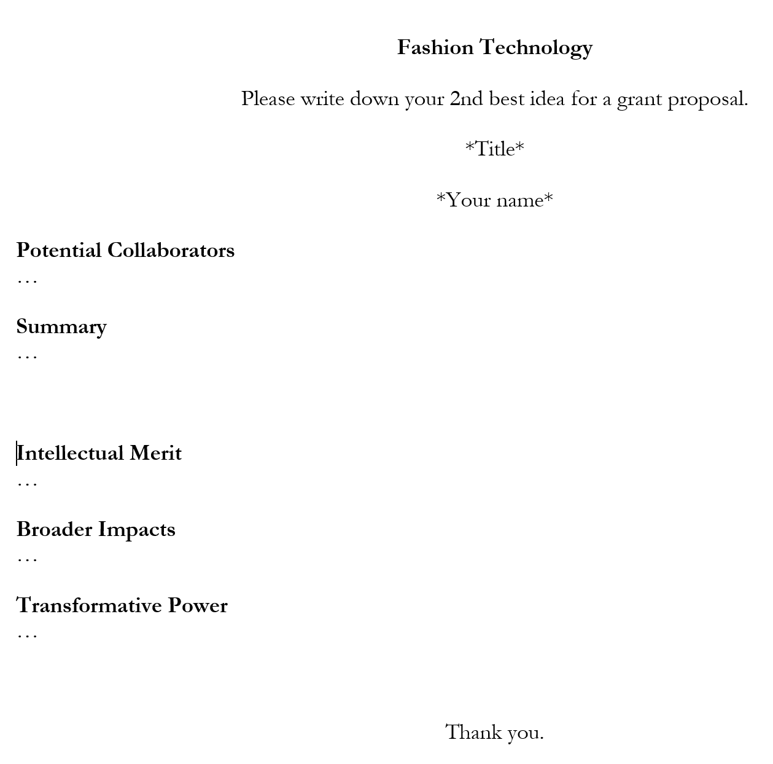
2nd Best Ideas
Use one hour of your life to envision what R&D we could do together over the coming 3 years assuming we had $1M.
Download form from https://tinyurl.com/y7w7ruwg
Submit result to katy@indiana.edu by 4pm on 4/26. Use “2nd” in subject header.
All who submit will get to see proposals of all who submitted.

Slide 19
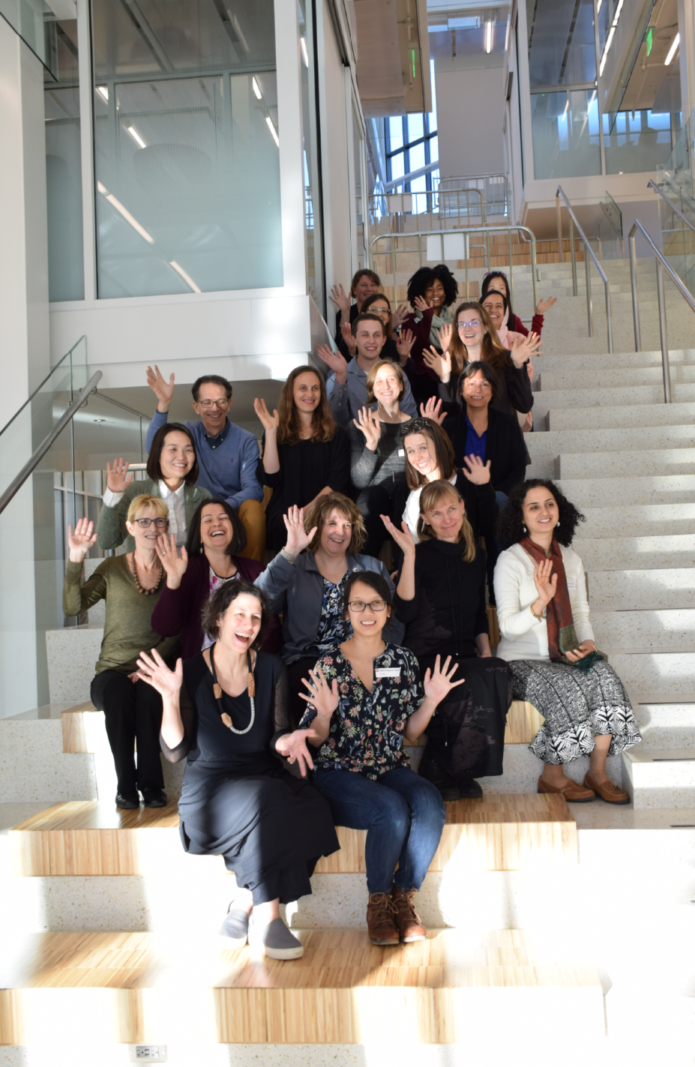
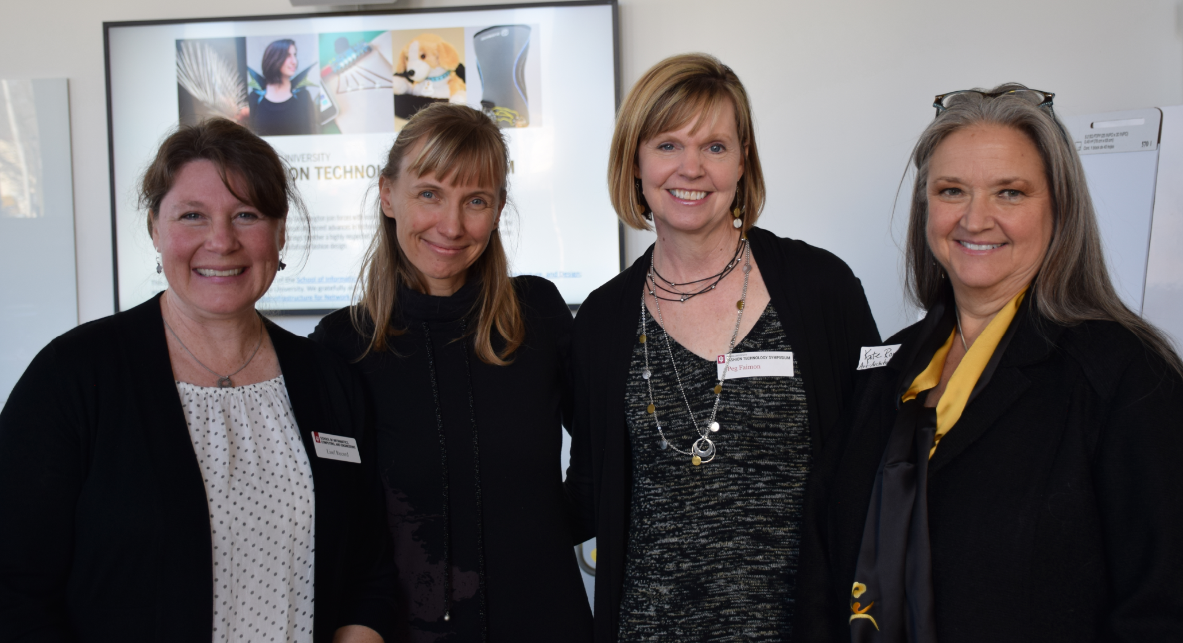
Replace
Please share your slides with Lisel/Katy!
Check back on https://iotw.cns.iu.edu for slides, videos, photos.
Continue to watch/use #IU-IoT

Slide 20
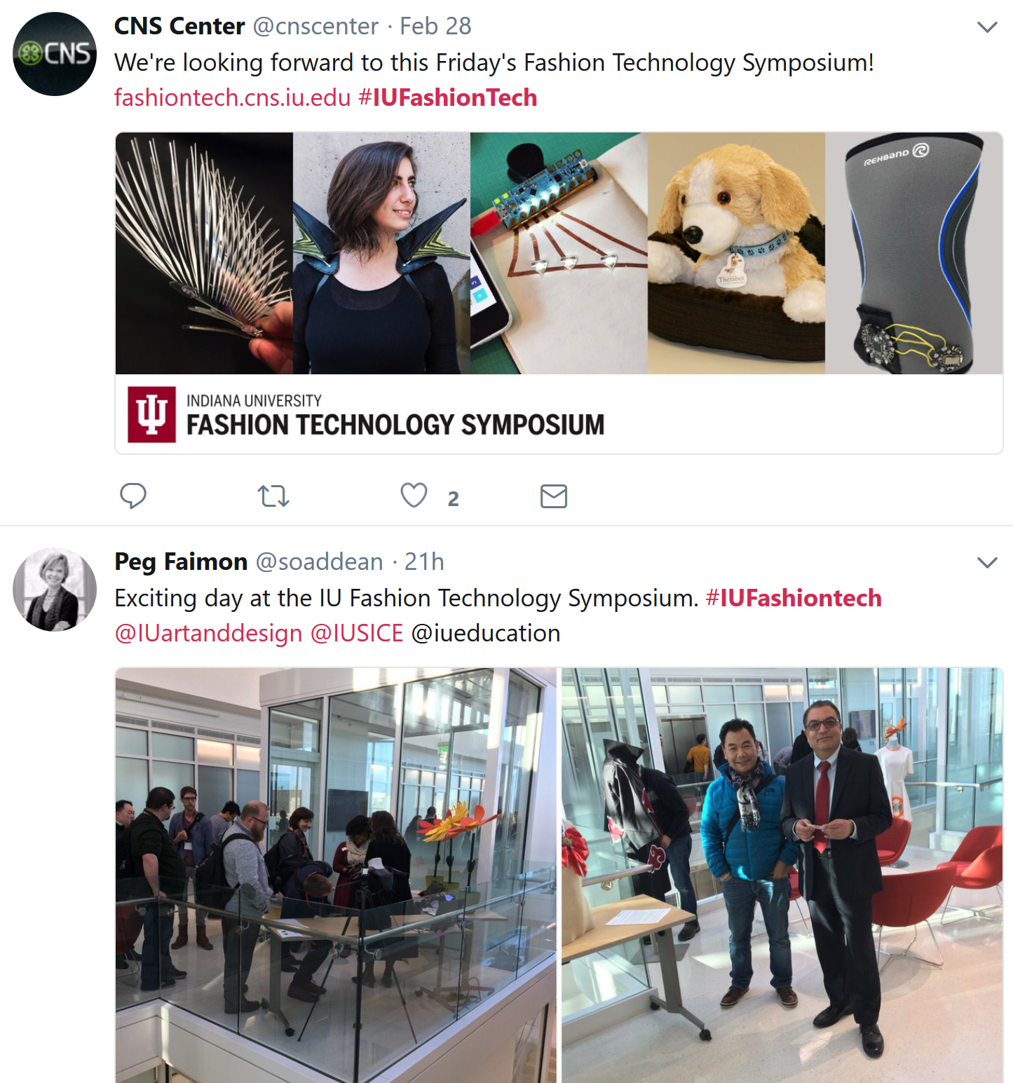
Replace

Slide 21
Acknowledgements
We would like to thank all those who assisted with the event:
Dave Cooley (sound and logistics)
Jill Clancy (event coordination)
Samantha Ginther (event coordination)
Alex Wukmer and his crew (set up)
Matt Martindale (event coordination)
Medina Sydykanova (event coordination)
Leonard Cross (website and print materials)
Tracey Theriault (signage)
We gratefully acknowledge financial and in-kind support for this event: Cyberinfrastructure for Network Science Center; Indiana University School of Informatics, Computing, and Engineering; Innovate Indiana; the IU Research and Technology Corp.; The Mill; the Regional Economic Development (RED) Fund; and the Indiana IoT Lab.

